Slide 1
Intrusion Detection Using Multiple Machine Learning Models
Presented By-
Mustavi Ibne Masum 18.02.04.040
Yumna Islam 18.02.04.046
Farhana Azad 18.02.04.068

Slide 2
What is Intrusion Detection?
Process of monitoring computer systems, networks, or applications for unauthorized access, malicious activity, or policy violations
Goal is to identify intrusion and respond to security incidents as quickly as possible in order to minimize any potential damage.

Slide 3
Importance of Intrusion Detection
Enabling quick effective response to security threats to minimize damage
Protects sensitive information
Prevention of downtime
Identification of vulnerabilities

Slide 4
Research
Gap
Maximum work using machine learning models have been done on binary classification(anomaly and non-anomaly).
Most of the datasets in this field are imbalance i.e. CICIDS2017,CICIDS2018,NSL-KDD

Slide 5
Dataset
NSL-KDD Dataset
An update to KDD’99 Dataset
2 training datasets(KDDtrain+,KDDtrain+_20percent)
2 testing datasets(KDDtest+ , KDDtest-21)

Slide 6
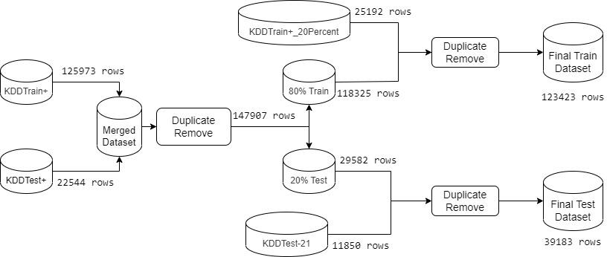
Dataset Preprocessing

Slide 7
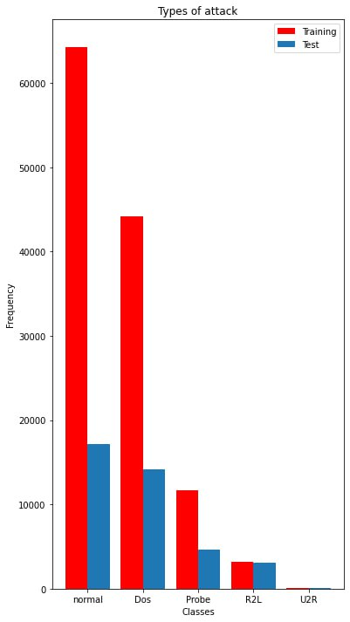
Dataset Preprocessing(cont.)
In total 41 features and 40 classes
Combining several classes
Creating new 5 classes by several merged classes.

Slide 8
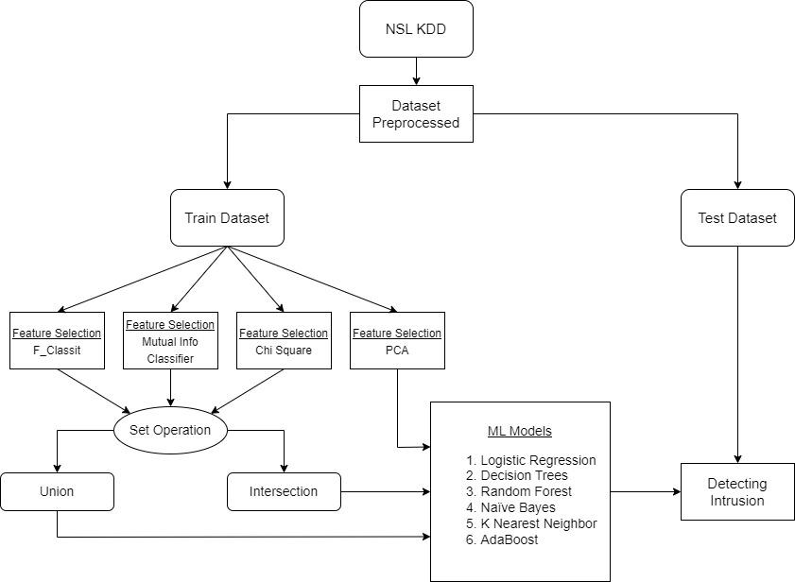
Methodology

Slide 9
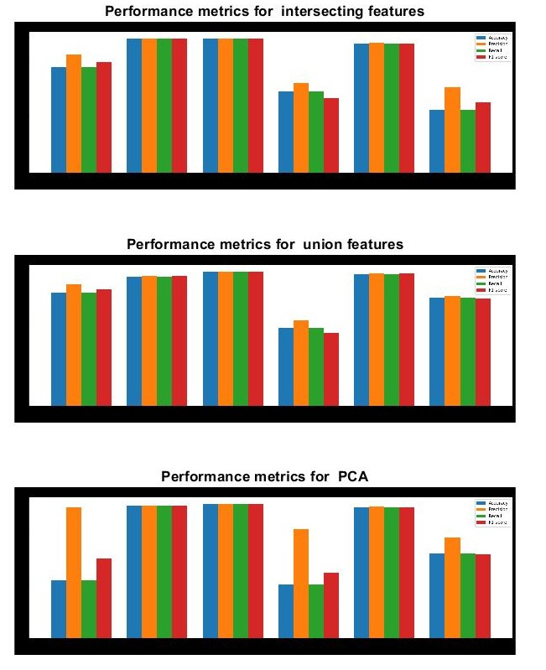
Experimental Result

Slide 10
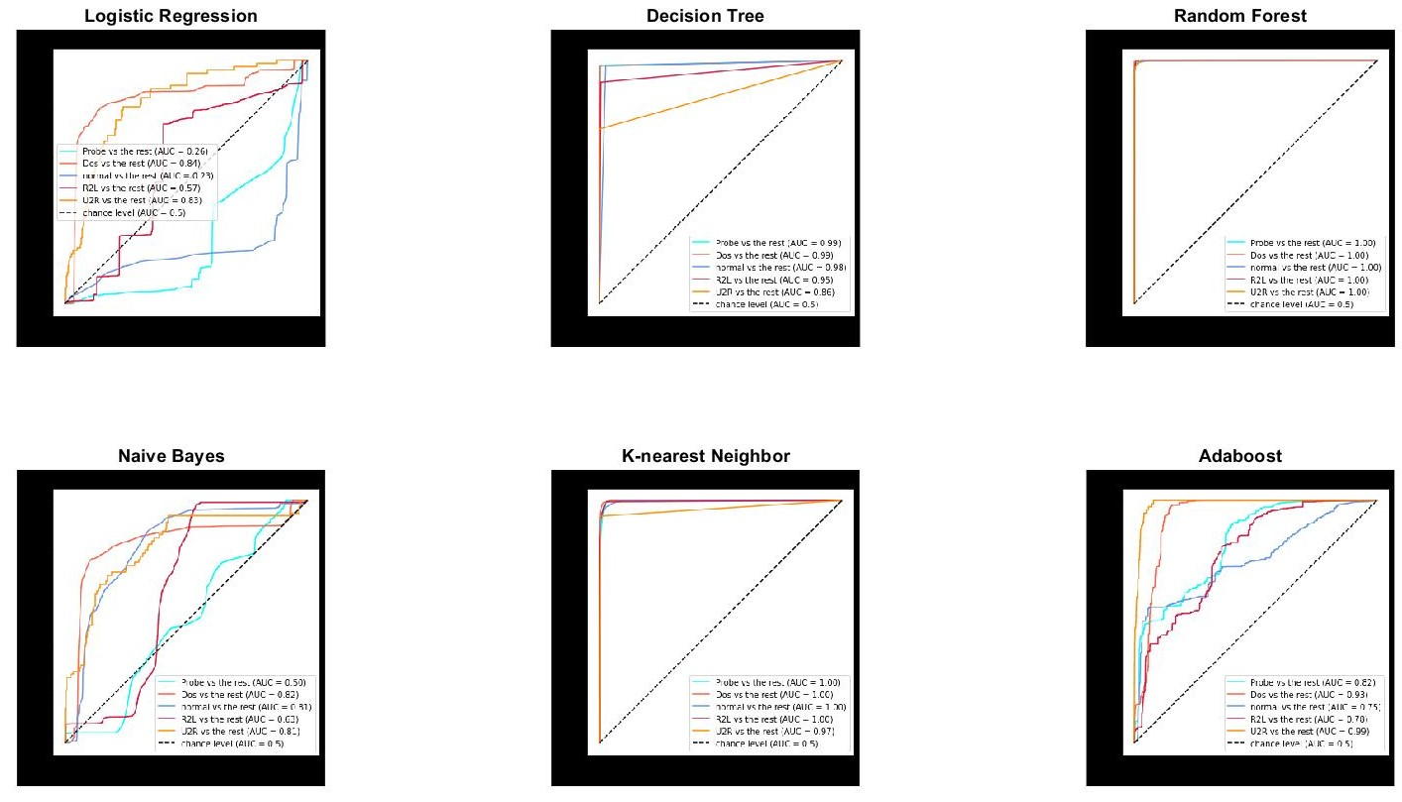
Experimental Result
PCA(Principal Component Analysis))

Slide 11
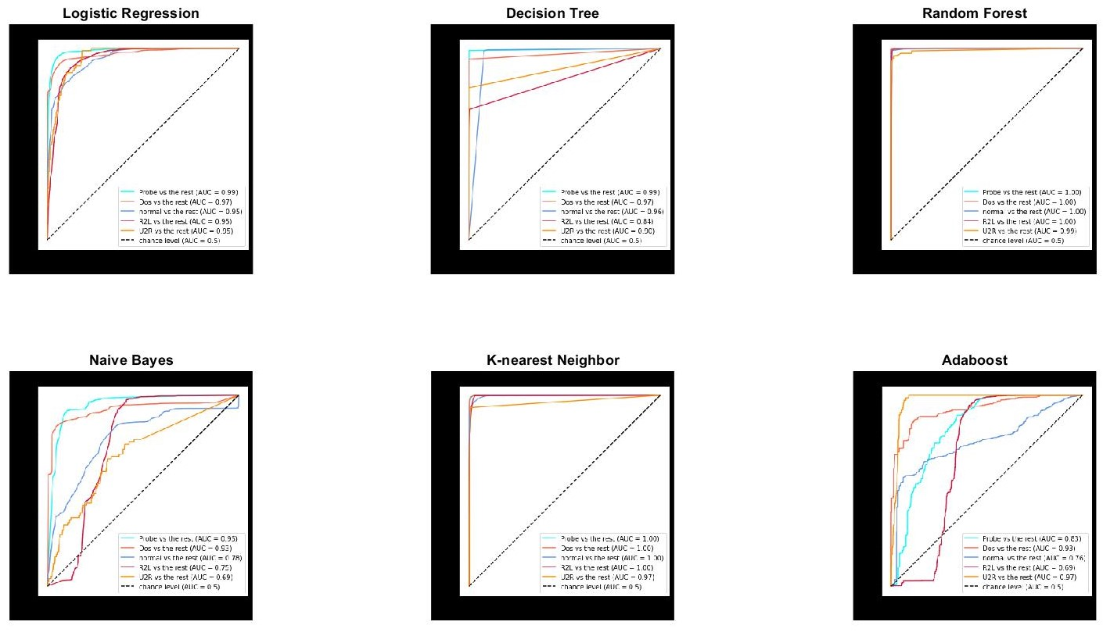
Experimental Result(Cont.)
Union Operation

Slide 12
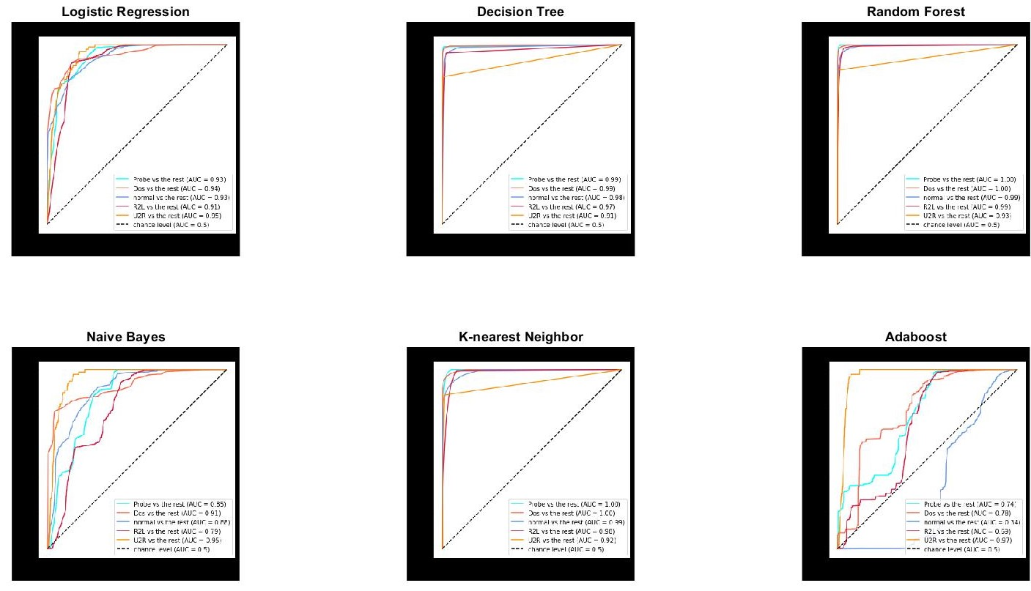
Experimental Result(Cont.)
Intersection Operation

Slide 13
Result Analysis
A comparative study has been shown
Random Forest Classifier works well in all scenarios
Decision tree and K-Nearest Neighbor also gives high accuracy
Naive bayes Classifier and Adaboost performs poorly
Logistic regression highly depends on number of features

Slide 14
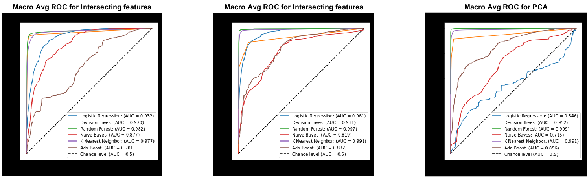
Macro Avg ROC for Different ML models

Slide 15
Conclusion
We have applied machine learning models for intrusion detection.
We can detect the anomaly and non-anomaly intrusions.
Good accuracy has been achieved in detecting types of anomalies.
Improvements are possible in this field as we have not implied every machine-learning model.

Slide 16
Thank You

